Slide 1
First Timers’ Breakfast
Susan Hamlin
Director, Communications and Member Services

Slide 2
First Timers’ Breakfast
Brief introductions
ARIN and the Internet registry system
Policy development at a glance
What’s ahead and how to participate
Q&A at your table

Slide 3

Self-introductions

Slide 4
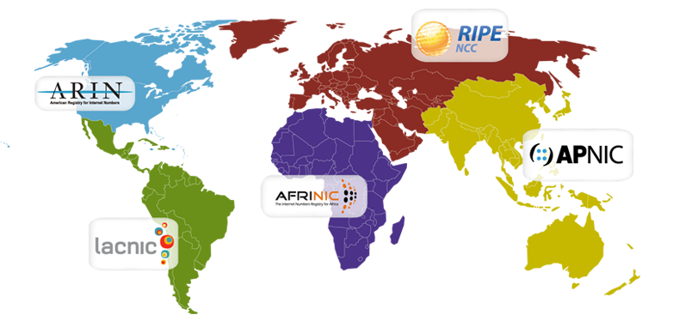
Regional Internet Registries (RIRs)
The system began in 1992
There are five RIRs:
  RIPE NCC, APNIC, then ARIN
LACNIC formed in 2002 out of ARIN region
AFRINIC formed in 2005 out of ARIN and RIPE NCC regions.

Slide 5
RIR Structure
Nonprofit | Membership Organization | Community-regulated
Fee for services, not number resources 100% community funded | Broad-based - Private sector - Public sector - Civil society | Community developed policies Member-elected executive board Open and transparent

Slide 6
RIR Services
Number Resources | Organization | Policy Development
IP address allocation & assignment ASN assignment Directory services Whois IRR Reverse DNS | Elections Meetings Information dissemination Website Newsletters Roundtables Training | Facilitate policy development process Maintain email discussion lists Conduct public policy meetings Publish policy documents

Slide 7
Who Provisions IP Addresses and ASNs?
ICANN IANA | Top level technical coordination of the Internet Names, Numbers, Root Servers Manage global unallocated IP address pool Allocate number resources to RIRs
RIR | Manage regional unallocated IP address pool Allocate number resources to ISPs/LIRs Assign number resources to End-users
ISP/LIR | Manage local IP address pool for use by customers and for infrastructure Allocate number resources to ISPs Assign number resources to End-users
Notes:
These are the organizations responsible for the distribution of IP number resources. The IANA (Internet Assigned Numbers Authority) is actually a US Government contract held by ICANN (Internet Corporation for Assigned Names and Numbers). IANA has always been responsible for the global pool of IP number resources.

Slide 8

Number Resource Provisioning Hierarchy
ICANN / IANA
(Internet Assigned Numbers Authority)
Manage global unallocated IP address pool
Allocate
RIRs
(AFRINIC, APNIC, ARIN, LACNIC, RIPE NCC)
Manage regional unallocated IP address pool
Allocate
Assign
ISPs
End Users
Re-Allocate
Re-Assign
ISPs
End Users

Slide 9
ARIN’s Mission
ARIN, a nonprofit member-based organization supports the operation of the Internet through:
  the management of Internet number resources throughout its service region;
  coordinates the development of policies by the community for the management of Internet Protocol number resources; and
  advances the Internet through informational
  outreach.

Slide 10
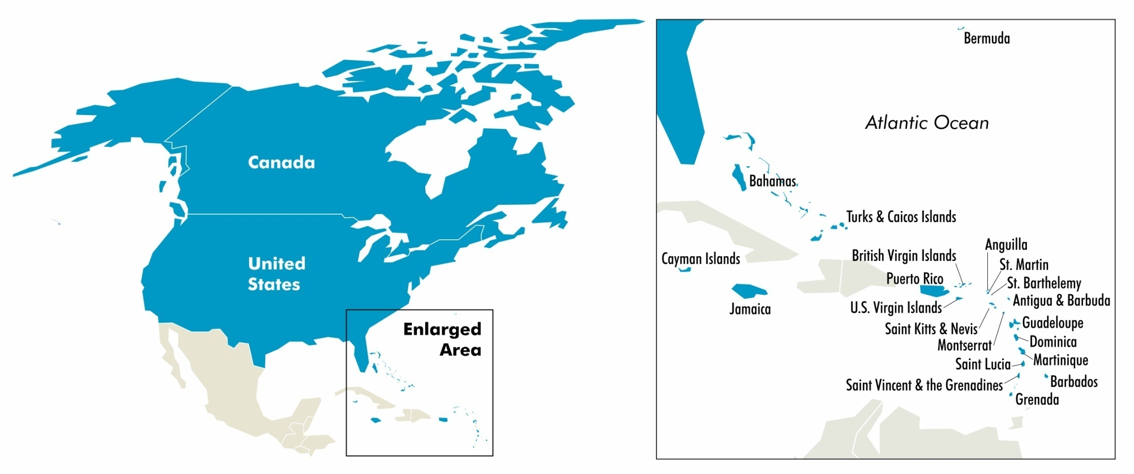
ARIN’s Service Region
ARIN’s region includes Canada, many Caribbean and North Atlantic islands, US Minor Outlying Islands and the United States.

Slide 11
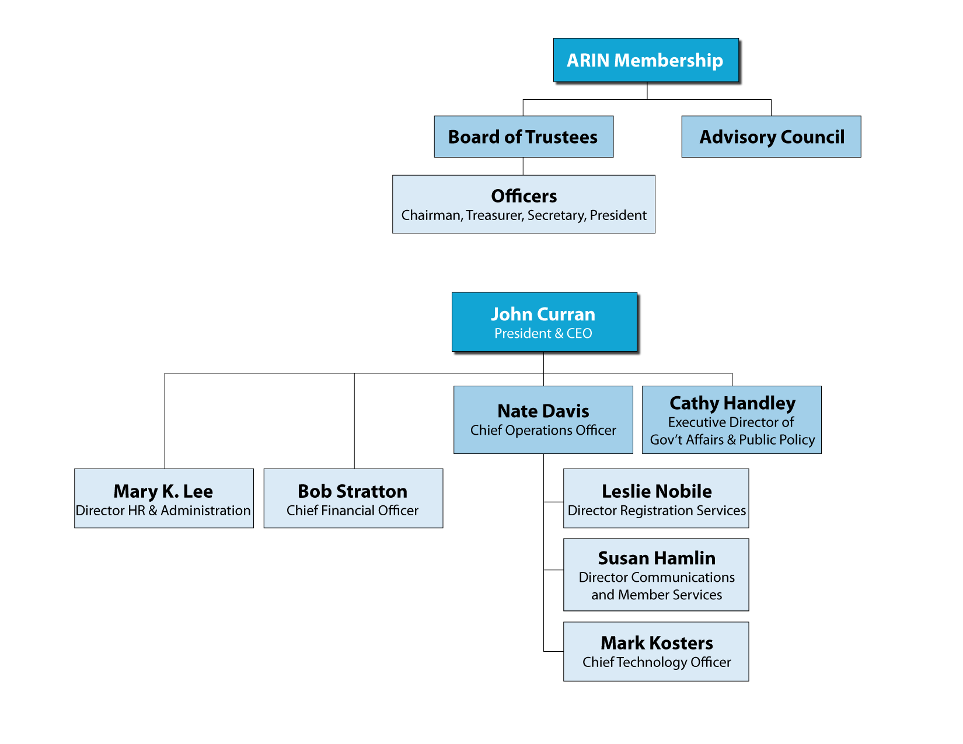
Organizational Chart

Slide 12
Registration Services
Coordination & management of Internet number resources
Internet number resource transfers
Directory Services
Registration transaction information (Whois)
Record maintenance
Routing information (Internet Routing Registry)

Slide 13

Technical Services
ARIN Whois/Whois-RWS
ARIN Online
Internet Routing Registry
Reverse DNS Services
DNSSEC
RPKI
IT support for organization

Slide 14
Organization Services
Information publication and dissemination
Education & outreach
Elections (Board, AC, NRO NC)
Policy development process
Public Policy and Member Meetings

Slide 15
Policy Development Principles
Open
  Developed in open forum
    Public Policy Mailing List
    Public Policy Meetings
  Anyone can participate
Transparent
  All aspects documented and available on website
    Policy process, meetings, and policies
Bottom-up
  Policies developed by the community
  Staff implements, but does not make policy

Slide 16
Who Plays a Role in the Policy Process?
Community
  Submits proposals
  Participates in discussions and petitions
Advisory Council (elected volunteers)
  Facilitates the policy process
  Develops policy:
    Enables fair and impartial resource administration
    Technically sound
    Supported by the Community
  Determines consensus based on community input
16

Slide 17
Roles…
ARIN Board of Trustees (elected volunteers)
  Provides corporate fiduciary oversight
  Ensures the policy process has been followed
  Ratifies policies
ARIN Staff
  Provides feedback to community
    Staff and legal assessments for all proposals
    Policy experience reports
  Implements ratified policies
17

Slide 18
Basic Steps
Community member submits a Proposal
AC works with submitter to ensure clear problem statement and suggested policy change
AC puts Draft Policy on PPML for community discussion/feedback (possibly presented at PPC/PPM)
AC decides: continue work or abandon
AC recommends fully developed Draft Policy (fair, sound and supported by community) for adoption
Recommended Draft Policy presented at PPC/PPM
If AC still recommends adoption, then Last Call and review of last call
Board review
Staff implements
18
Notes:
There are numerous points for possible petition along the way if someone is unhappy with an AC action or lack of action.

Slide 19
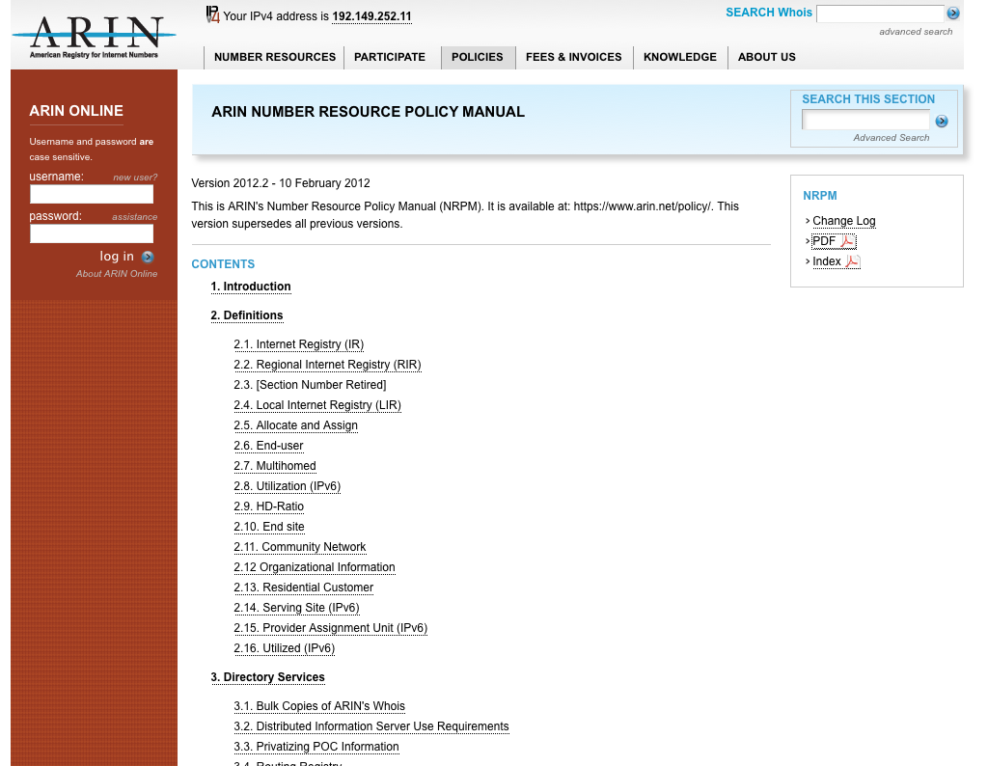
Number Resource Policy Manual
http://www.arin.net/policy/nrpm.html
Policies Covered:
IPv4 Address Space
IPv6 Address Space
Autonomous System Numbers (ASNs)
Directory Services (WHOIS)
Reverse DNS (in-addr)
Transfers
Experimental Assignments
Resource Review Policy

Slide 20
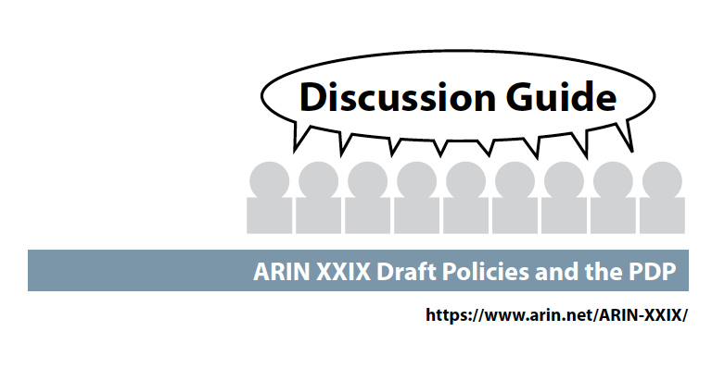
Draft policies at this meeting:
ARIN-2012-2: IPv6 Subsequent Allocations Utilization Requirement
ARIN-2013-1: Section 8.4 Inter-RIR Transfers of ASNs
ARIN-2013-2: 3GPP Network IP Resource Policy
ARIN-2013-3: Tiny IPv6 Allocations for ISPs

Slide 21
How to monitor and not be overwhelmed?
Once a month:
Front page of the website leads to proposals and draft policies under discussion
  New proposals need feedback for the AC’s initial decision
  Web site can help you focus on what’s important to you and your company
Twice per year:
Check the ARIN Public Policy Meeting site in the weeks leading up to the meeting
  Proposals/Draft Policies on Agenda
  Discussion Guide (summaries, text, staff assessments)
  Attend in Person/Remote
AC meeting last day: Watch list for AC’s decisions, Last Calls –
State your opinion, are you For or Against?

Slide 22
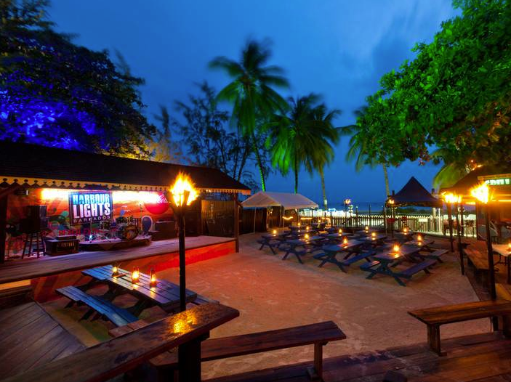
What’s Ahead this week
Needhams 1& 2
Today:
ARIN Public Policy Meeting 9:00 AM – 4:00 PM
ARIN social – Harbor Lights
(Buses leave starting at 6:15)
Tuesday: ARIN Public Policy Meeting, 9:00 AM – 4:00 PM
Wednesday: ARIN Members Meeting (open to all), 9:00 AM – Noon

Slide 23
Ways to participate this week:
Membership is not required ☺
Meet your fellow attendees at meals and during breaks
Join a lunch table topic discussion led by the AC on Monday or Tuesday
ARIN Board, Advisory Council, NRO Number Council and Staff all have ribbons on our name tags – seek us out and ask questions
Go the floor microphones in the meeting room, be sure to state name and organization upfront
Raise your hand to voice your opinion when votes are taken during policy discussions

Slide 24
Don’t Forget Your Survey
Please complete the survey form and drop it in the bowl.
Be present in the meeting room this afternoon for the drawing – you might win a $100 Think Geek gift certificate.

Slide 25
Questions?

Slide 26
Reference Material

Slide 27
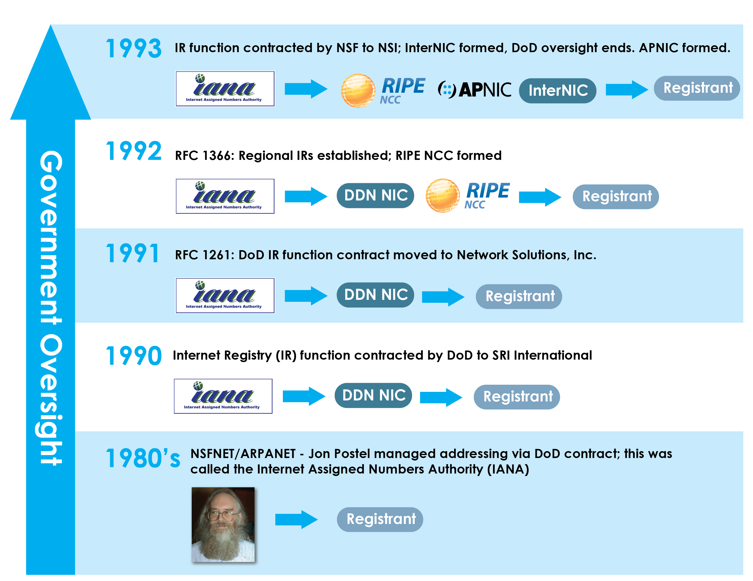
Historical Timeline

Slide 28
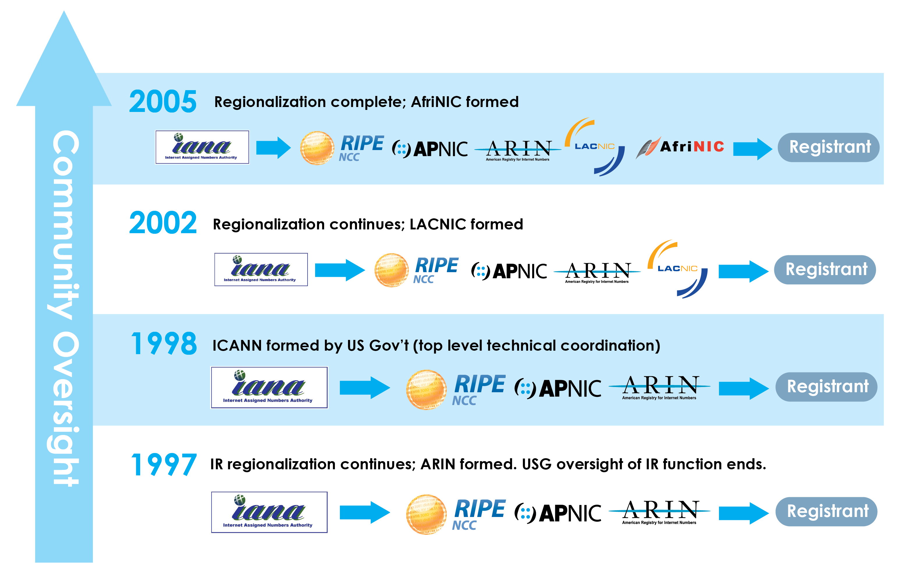
Historical Timeline

